Slide 1
Policy 147C
How to easily violate it
Notes:
Policy 147C is the catch all policy for the authority drug and alcohol abuse policy.

Slide 2
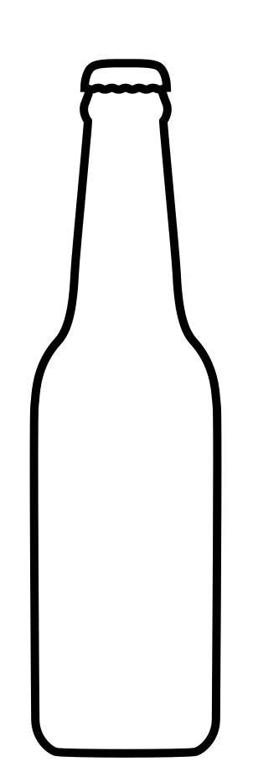


Notes:
A serving of an alcoholic beverage-
a bottle or can of beer
a shot of spirit
a glass of wine
A serving of any has approximately the same effect on your Blood Alcohol Content when drank in the same amount of time.

Slide 3


LD50 For Adults
10 to 22
0.45%
Legal Driving Limit
2 to 5
0.08%
Likely Termination
0.02%
Notes:
The different levels of intoxication when consumed in 1 hour
.45% BAC is the Lethal dose for adults.
LD50 is the lethal dose that will kill half of those affected.
10-22 beers depending on gender and body weight
.08 is the legal driving limit
2 to 5 drinks depending on gender and body weight

Slide 4
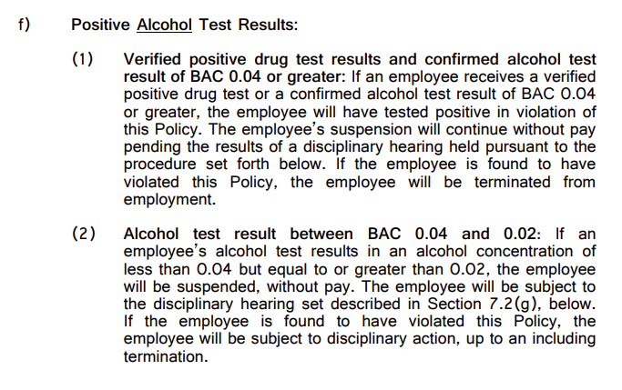
Policy 147C Section 7.2
Notes:
.04% and above is a definite termination if the hearing finds you in violation
.02% to .039% will almost always result in termination if the hearing finds you in violation.

Slide 5
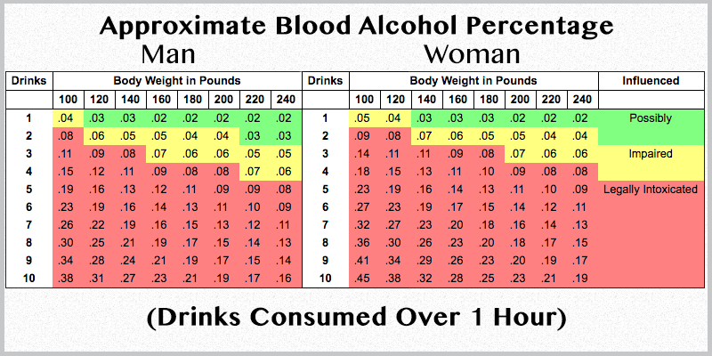
Notes:
Emphasize that at all body types a single drink within an hour lunchbreak can cost them their job.

Slide 6
End

